Slide 1
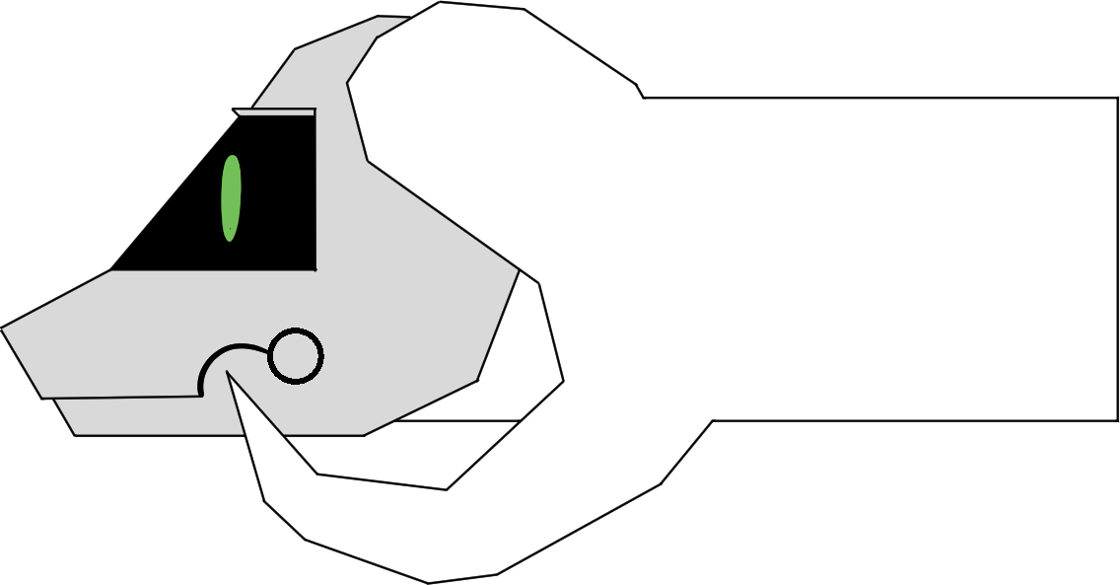
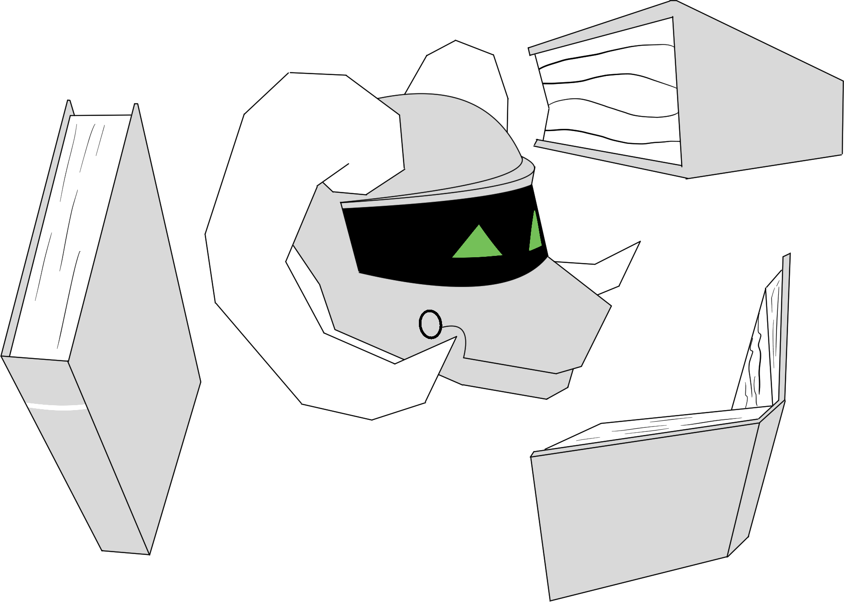
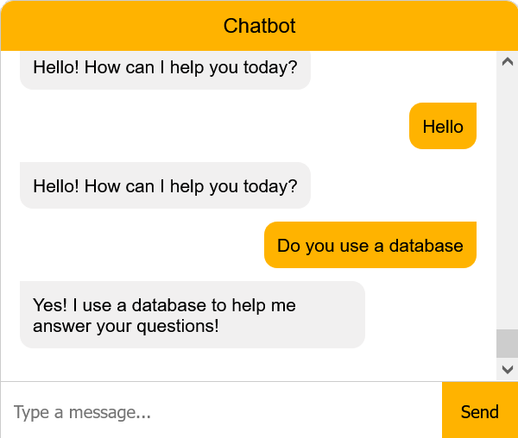
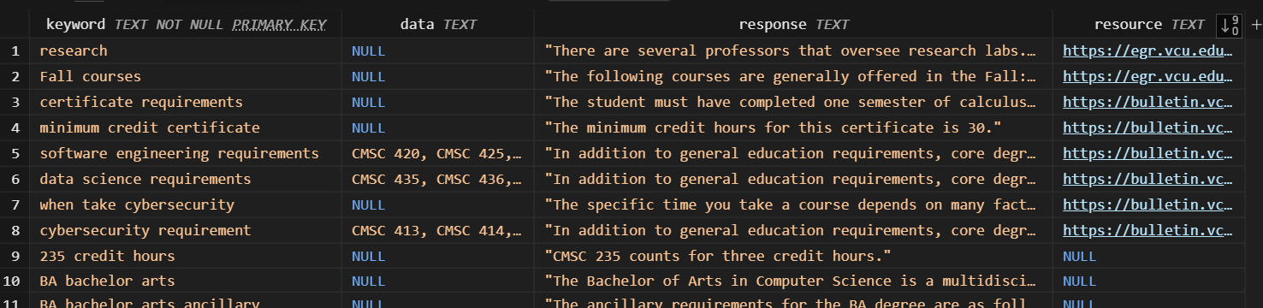
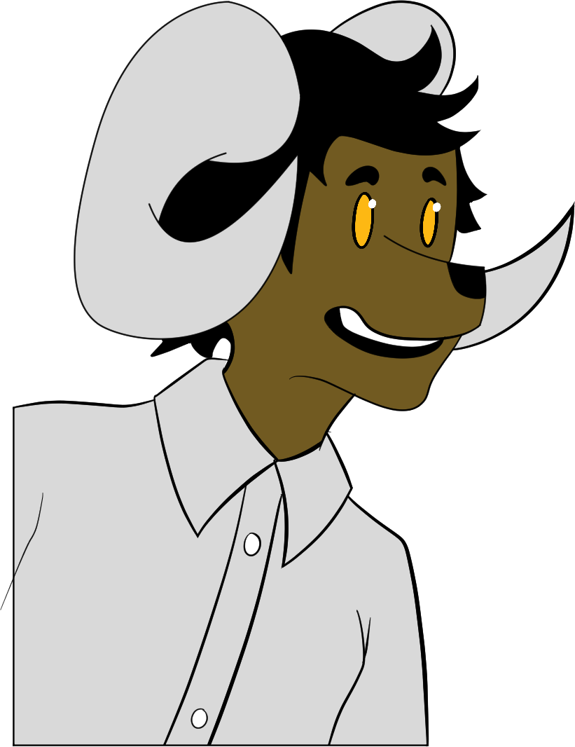
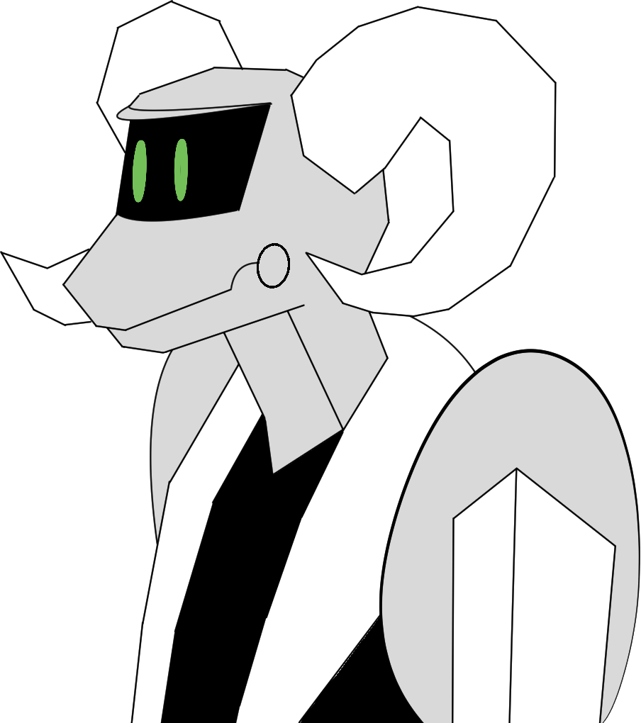


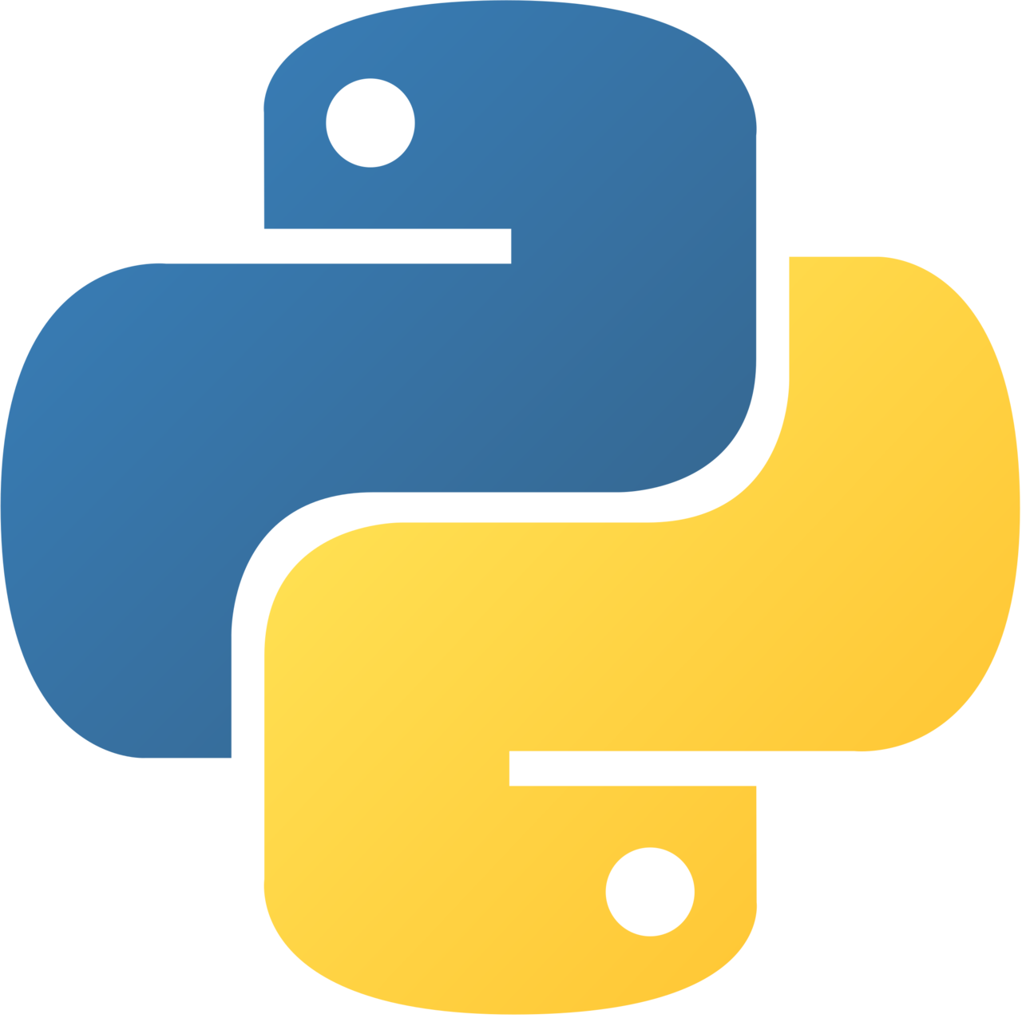



25-314
Computer Science Chatbot
Team members: Kennedy Martin, Israel Agoe-Sowah, Eric Simoni, Antony Fuentes | Faculty adviser: Caroline Budwell, Ph.D. | Sponsor: Virginia Commonwealth University |
Overview
How
Goal:
Build a chatbot for the VCU Computer Science webpages
The chatbot will answer FAQ’s about the program for current or incoming undergraduate students.
Why:
Accurate information
Main source for program information
Saves faculty resources
Build a Database:
Database columns: keywords, data, response, resource
Query the database using the keywords
Python Program:
Communicate with the front end to retrieve the question
Send the question to the NLP for cleaning and keyword retrieval
Receive the keywords and use them to query the database
Send the response back to the chatbot
Chatbot
Checks the database
Outputs to the user
What can you show me?
Next Steps
I'm here to assist in answering questions about the Comp-Sci degree program!
Continue building the database
Testing
Set up storage of database and program
Implementation on site
Determine access
Determine maintenance
So you can help me getting started? I have no idea what classes I need.
For Sure!

